Slide 1

Course: CIS 411 – Database Systems QuickMart: Retail Store Management Database
group Members: Gracy Patel, La’Ron Hampton, Amaree Ryans, Yash Patel, Micah Shepherd

Slide 2
Project Introduction
QuickMart is growing — but its manual system isn’t. From groceries to household goods, daily operations became slow and error-prone.
💡 Our solution? A smart, relational database in Microsoft Access. It streamlines orders, tracks inventory, and boosts efficiency.
📈 Built for today. Ready for tomorrow.

Slide 3
Purpose of the System
Why did we build this system? To make QuickMart faster, smarter, and more organized.
Track customer orders and purchase history Monitor inventory in real time Manage employees and supplier details Generate reports for better decisions

Slide 4
Main Entities & Relationships
How they connect:
A Customer places multiple Orders
Each Order contains many Order Items
Every Order Item links to one Product
Each Product comes from one Supplier
An Employee can handle multiple Orders
Key Entities:
Customers
Orders
Order Items
Products
Suppliers
Employees

Slide 5
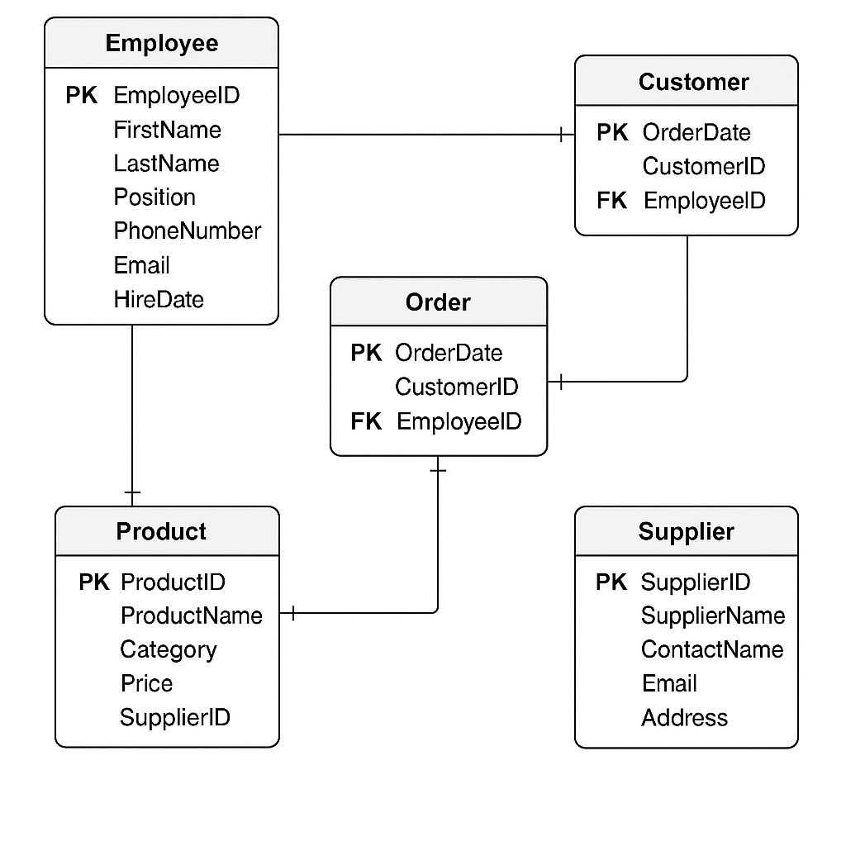

Slide 6
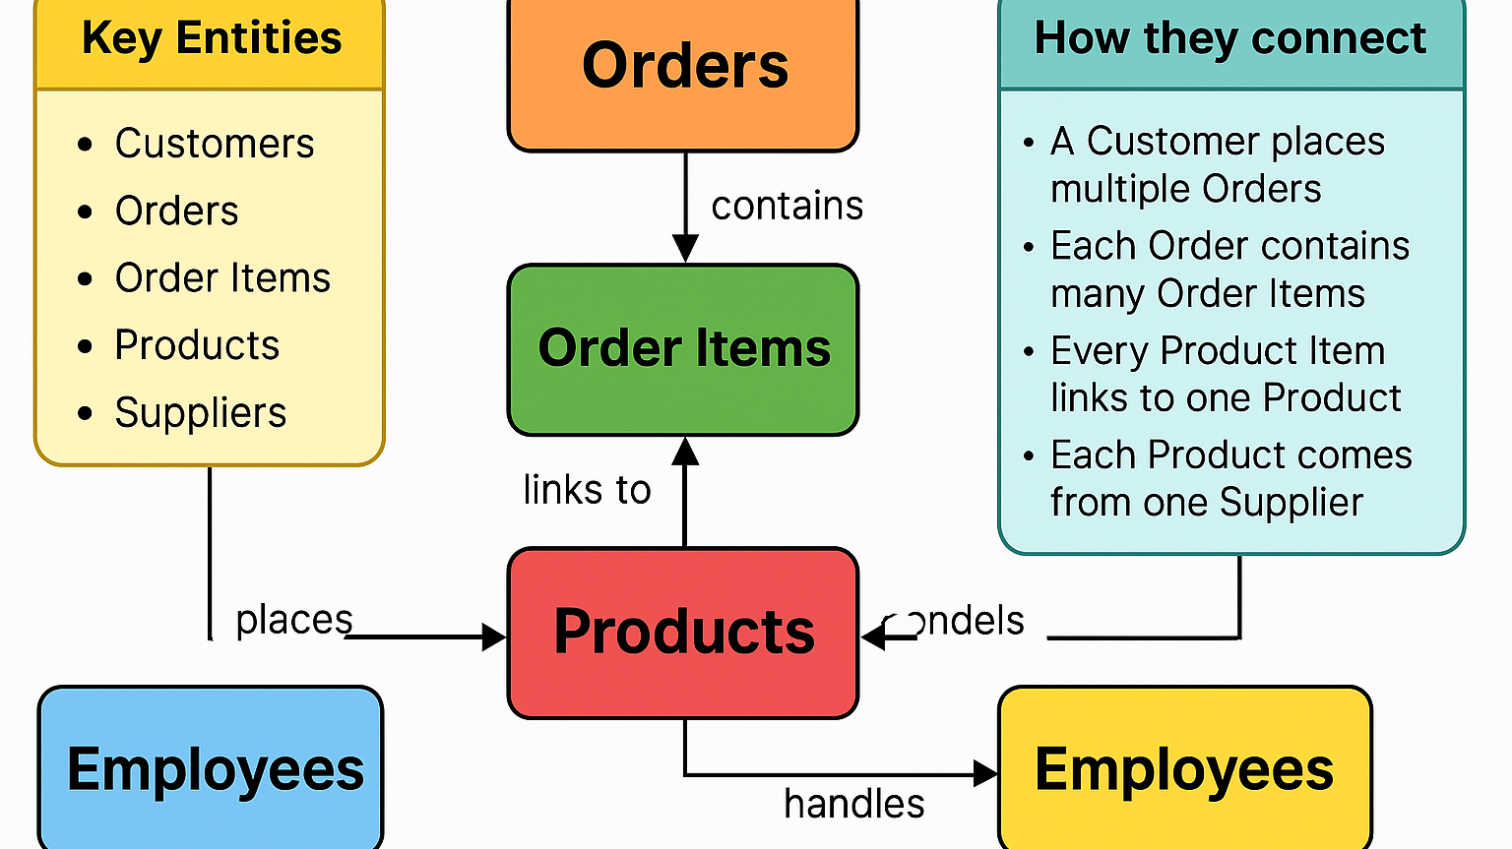

Slide 7
Functional Dependencies
CustomerID → Name, Email, Phone
EmployeeID → Name, Role, Phone
SupplierID → Name, Phone
ProductID → Name, Price, Stock, SupplierID
OrderID → CustomerID, EmployeeID, OrderDate
(OrderID, ProductID) → Quantity, Price

Slide 8
Normalized Schema (3NF)
1. CUSTOMERS CustomerID (PK), Name, Email, Phone
2. EMPLOYEES EmployeeID (PK), Name, Role, Phone
3. SUPPLIERS SupplierID (PK), Name, Phone
4. PRODUCTS ProductID (PK), Name, Price, Stock, SupplierID (FK)
5. ORDERS OrderID (PK), CustomerID (FK), EmployeeID (FK), OrderDate
6. ORDERITEMS OrderItemID (PK), OrderID (FK), ProductID (FK), Quantity, Price

Slide 9
SQL DDL (Table Creation)
CREATE TABLE Customers (
CustomerID INT PRIMARY KEY,
Name VARCHAR(100),
Email VARCHAR(100),
Phone VARCHAR(15)
);
CREATE TABLE Orders (
OrderID INT PRIMARY KEY,
CustomerID INT,
EmployeeID INT,
OrderDate DATE,
FOREIGN KEY (CustomerID) REFERENCES Customers(CustomerID),
FOREIGN KEY (EmployeeID) REFERENCES Employees(EmployeeID)
);

Slide 10
SQL Queries
Query 1 – Orders with Customer Names (2 tables):
SELECT Orders.OrderID, Customers.Name
FROM Orders
JOIN Customers ON Orders.CustomerID = Customers.CustomerID;
Query 2 – Order Details with Product Info (3 tables):
SELECT Orders.OrderID, Products.Name, OrderItems.Quantity
FROM Orders
JOIN OrderItems ON Orders.OrderID = OrderItems.OrderID
JOIN Products ON OrderItems.ProductID = Products.ProductID;
Query 3 - Employee, Order, Customer, Product (4+ tables):
SELECT Employees.Name AS Employee, Customers.Name AS Customer, Products.Name AS Product
FROM Employees
JOIN Orders ON Employees.EmployeeID = Orders.EmployeeID
JOIN Customers ON Orders.CustomerID = Customers.CustomerID
JOIN OrderItems ON Orders.OrderID = OrderItems.OrderID
JOIN Products ON OrderItems.ProductID = Products.ProductID;

Slide 11

Forms & Reports
Forms Designed:
Customer Entry Form: Add and update customer details
Order Entry Form (with Subform): Create orders and list order items
Product Form (with Supplier Lookup): Add products and link them to suppliers
Reports Generated:
Sales by Date Report: Displays sales data organized by date
Inventory Status Report: Monitors current stock levels and identifies low-stock products

Slide 12
Navigation Form
Features of the Navigation Form:
Central access point to all major forms and reports
Streamlined design for ease of use by store staff
Allows quick navigation between:
Customer Form
Order Form
Product Form
Supplier Form
Reports Section

Slide 13
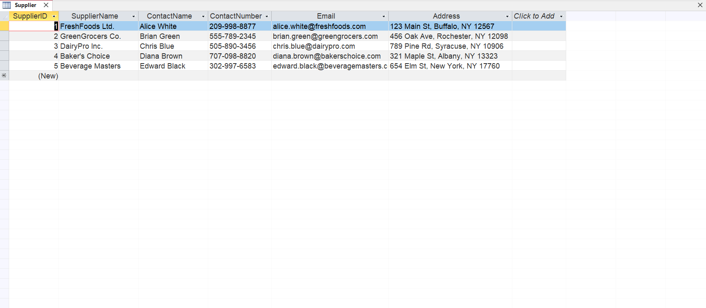

Slide 14
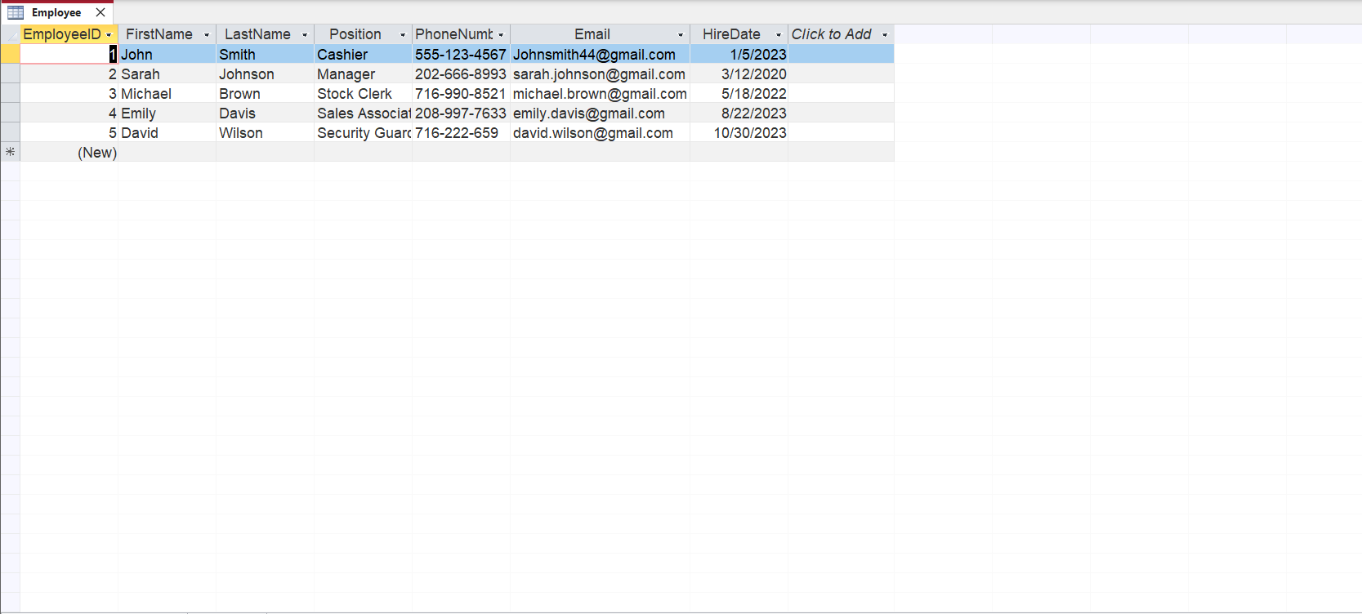

Slide 15
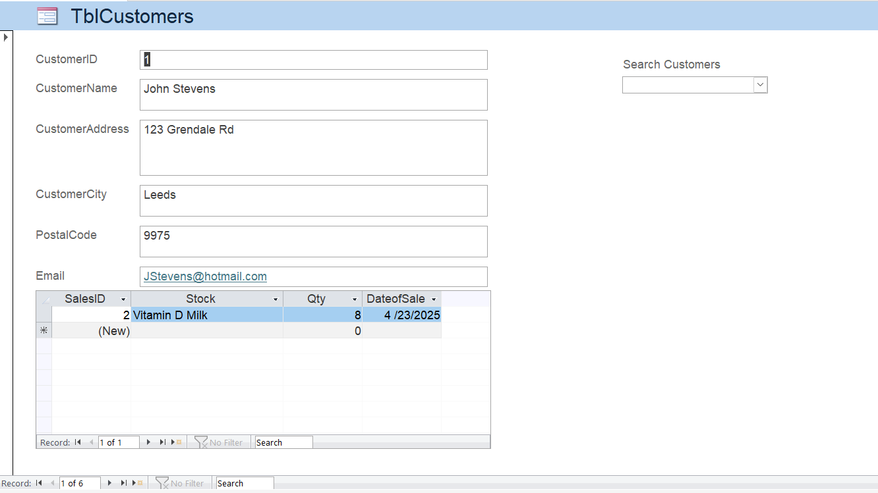

Slide 16
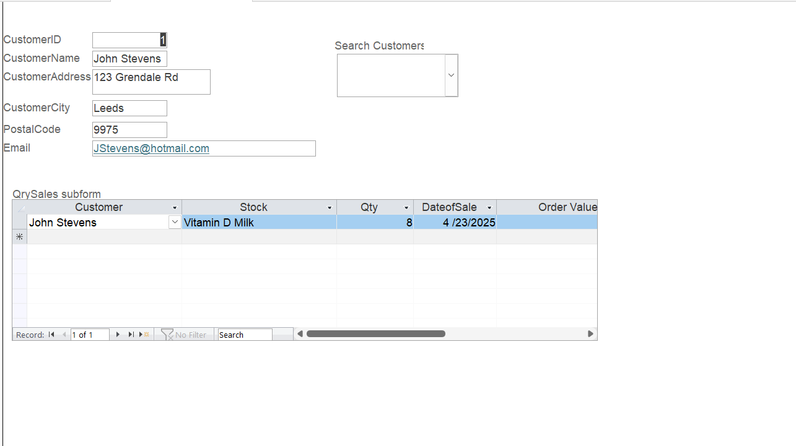

Slide 17
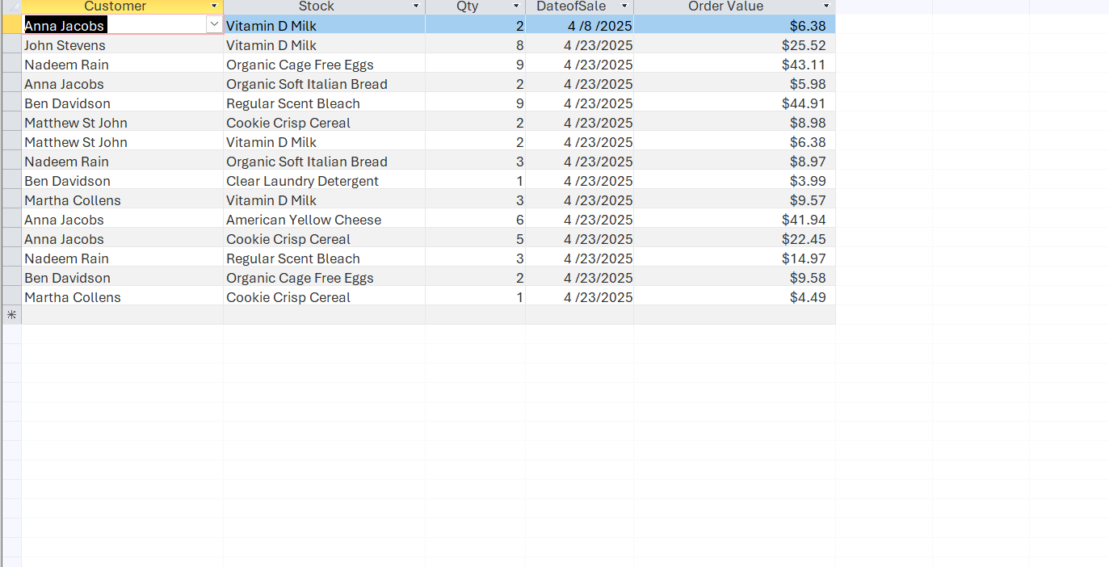

Slide 18
Team Contributions
🛠️ Gracy Patel
Interface design
Database creation in Access
Finalized forms and navigation form
Lead on documentation
🔧 La’Ron Hampton
Led Access database development
SQL scripting and query integration
Co-developed forms with Gracy
🧪 Yash Patel
Developed and tested user forms
Implemented and validated SQL queries
🧾 Amaree Ryans
Application testing and feedback
Captured screenshots
Supported report formatting
📐 Micah Shepherd
Report layout and design
Grammar and content editing
Presentation formatting

